Slide 1

Development of machine learning models to process Electronic Health Records – Imputation Strategies
Week 17 Meeting, 13/2/2021

Slide 2
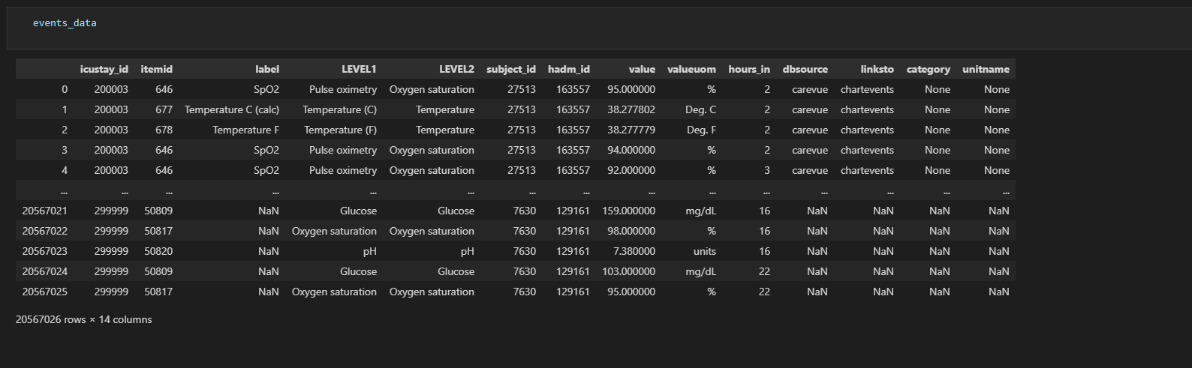

Slide 3
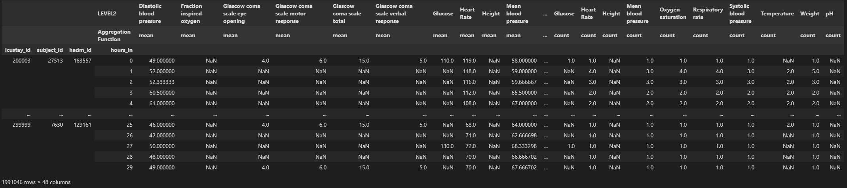
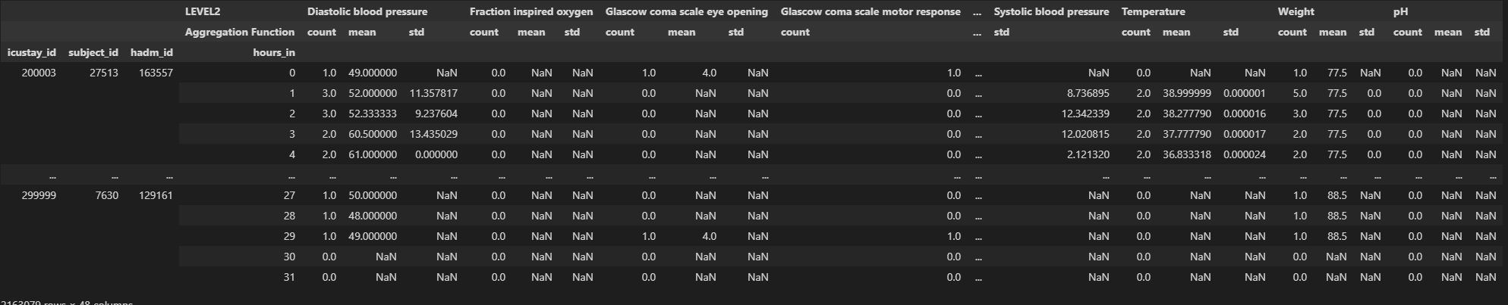

Slide 4
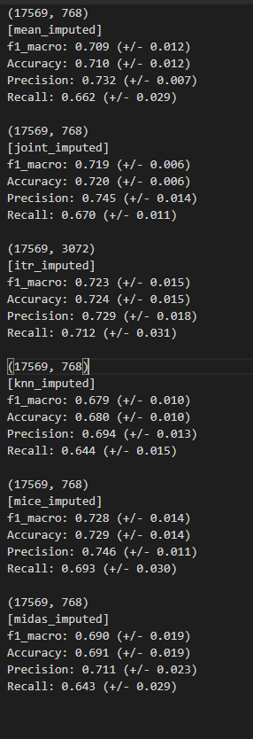
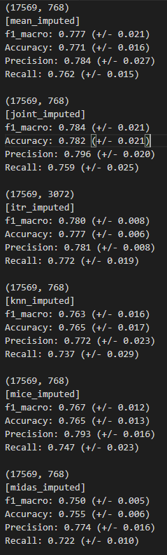
Logistic Regression
Random Forest

Slide 5
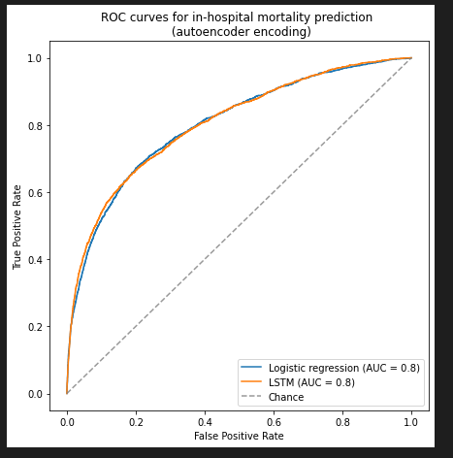
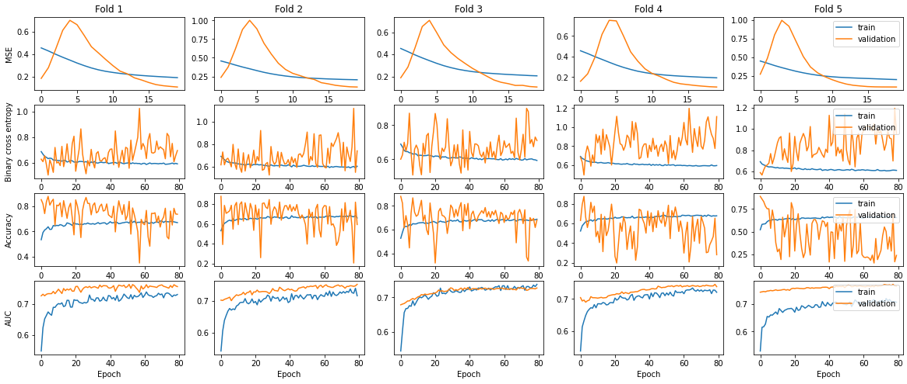
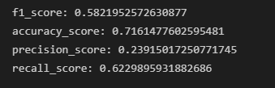
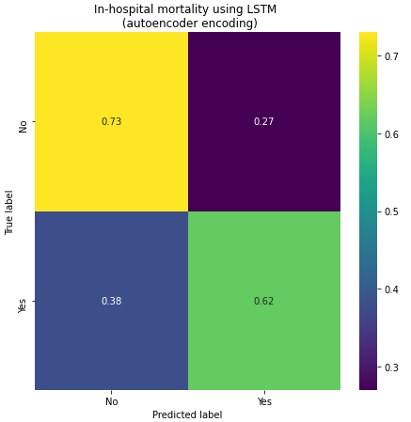
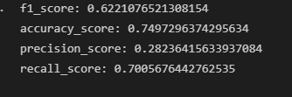
Deep learning
From my notebook
From inhospital_mortality_AutoencoderEncoding

Slide 6
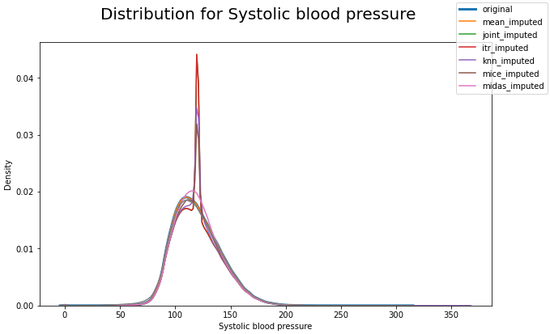
Although mean, joint, and itr_imputed have good results for classification, it does not follow the general trend and shape of the data

Slide 7
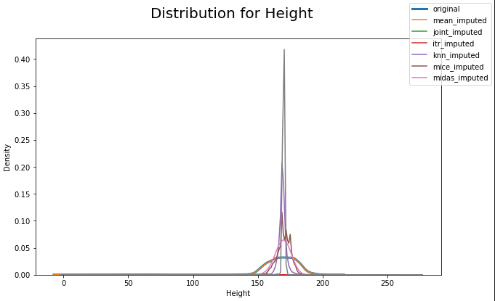
It is obvious in quite a few cases KNN and deep learning is has a closer distribution to the original data

Slide 8
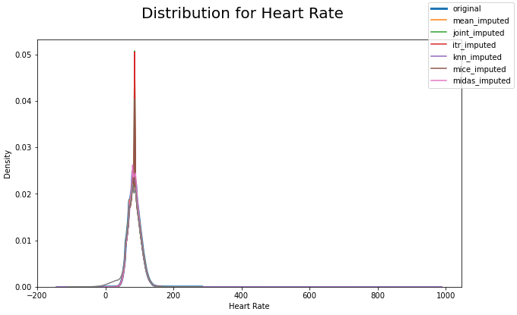
-The more samples, the more steady and accurate the imputation

Slide 9
Discussion
Should I be discussing in terms of imputation, achieving good performance should not be the only measure of success
As the aim of imputation is to fill missing data as closely as the original data
Measure of success
Root mean squared error (increase the amount of missing values)
Distribution (kl-divergence)
Classification performance
Masked data prediction (imputation accuracy)
Should I be doing this at the imputation stage?
But removing more missing data will only reduce the accuracy of imputation as it has less data to impute from?

Slide 10
Comparing imputations

Slide 11
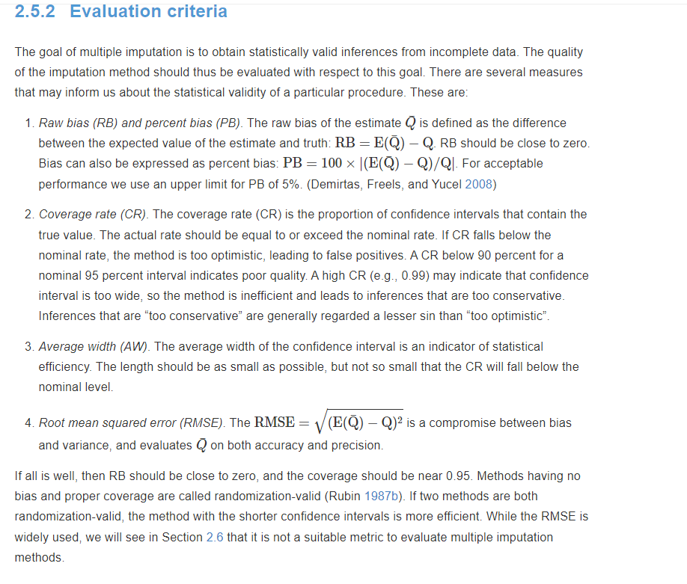

Slide 12
Switching focus
Is it possible to switch focus to creating an extraction pipeline
Show feature iimportance and select import features only
Using feature selection on different imputed data to find corelation

Slide 13
Feature importance analysis

Slide 14
Plan for upcoming weeks
Jan 31- Feb 7: Create comparison metrics pipeline + Optimize models (make changes) + feature selection
Feb 7 – Feb 14: Look at extraction Pipeline + masked data prediction
Finish introduction and background
Feb 14 – Feb 21: Add imputation methods if all models are optimized + Deep learning classification
Finish Analysis/ requirements
Feb 21 – Feb 28: Design, Implementation
Feb 28 – Mar 7: Evaluation, Conclusion
Mar 7 - Mar 14: Complete First Draft 2 weeks before deadline

